Slide 1
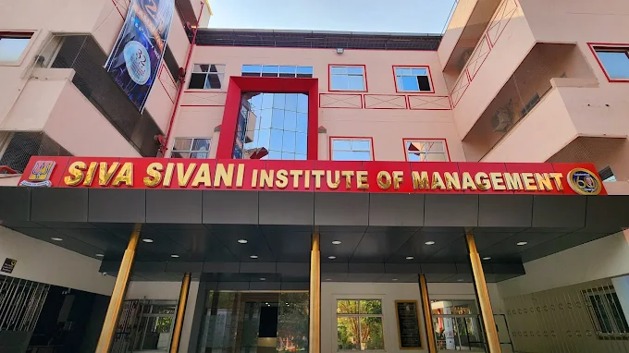
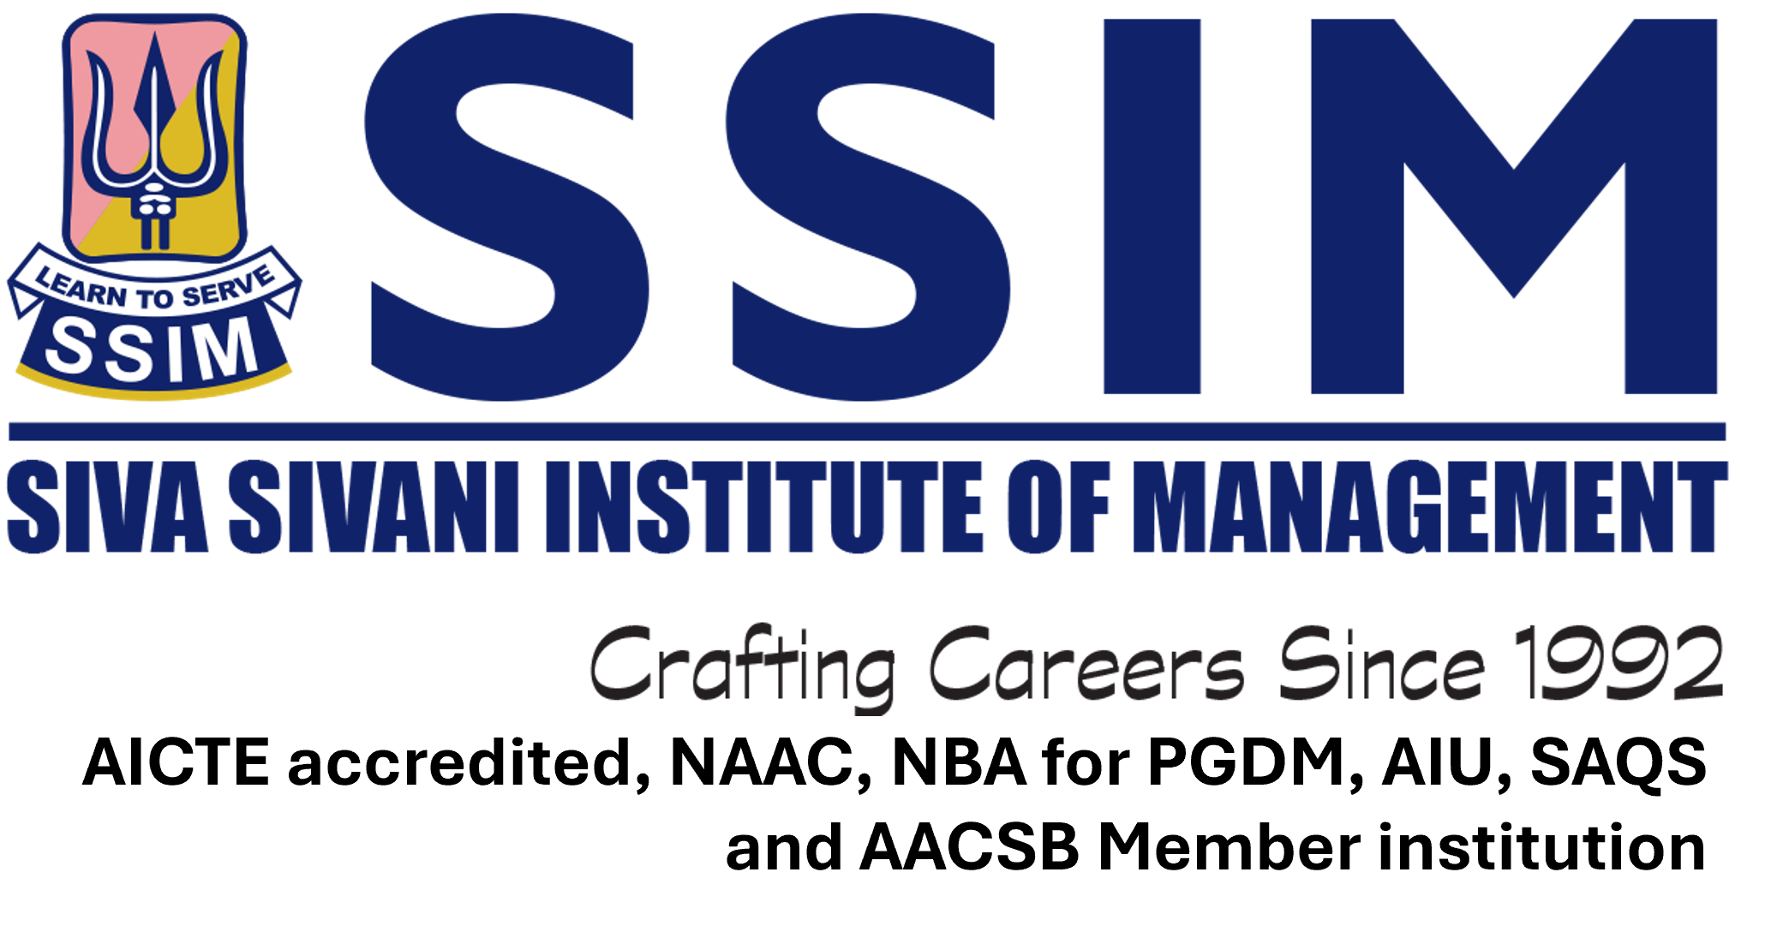
Siva Sivani Institute of Management
Preparing Minds for the Business of Tomorrow

Slide 2
About SSIM
A Premier Institution with over Three Decades of excellence in management education
Renowned for its Strong Ethical Foundation
Delivers Industry-Relevant learning that blends academic and corporate insights
  Innovative Curriculum
  Experienced Faculty
  Rich Corporate Mentoring
  Practical On field Applicability
  Blended Learning Platforms
  Latest Technological Integration

Slide 3
About SSIM
Focus on Holistic Development of Individual Personality with emphasis on:
  Critical Decision-Making
  Creativity
  Innovation
  Sustainability
  Ethics
  Managerial Competency Development Components
Proud of vibrant, extremely qualified, and talented alumni network spanning across the globe, across industries, across domains, and across profiles.
SSIM continues to shape future-ready leaders year-on-year………………

Slide 4
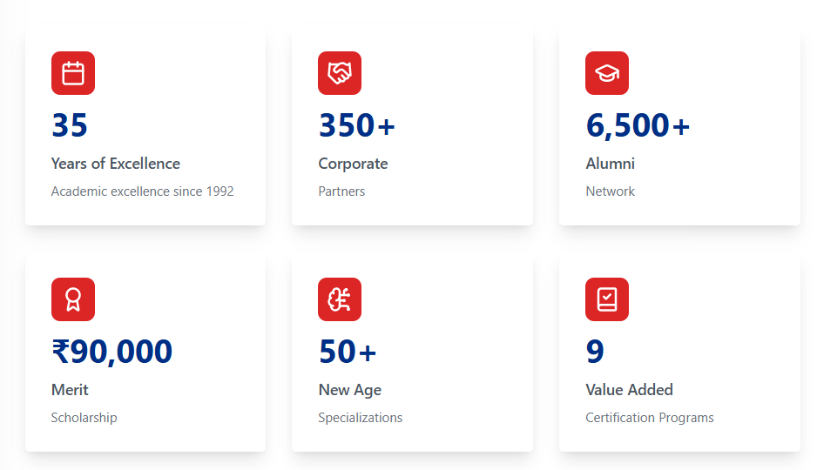
About SSIM

Slide 5
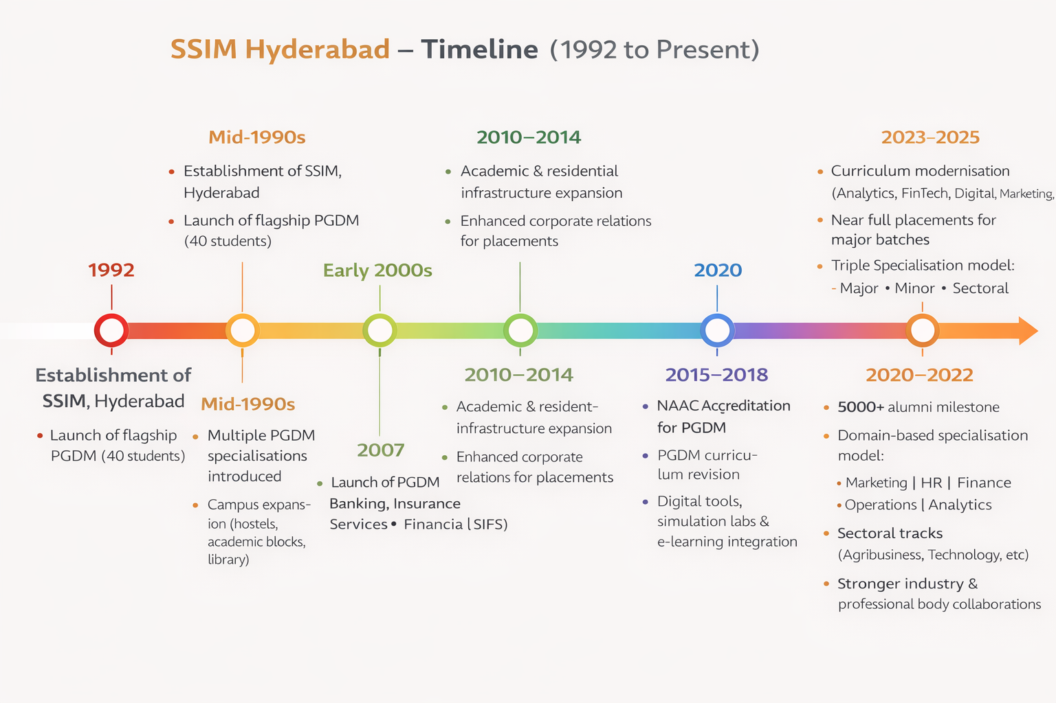
SSIM Timeline

Slide 6




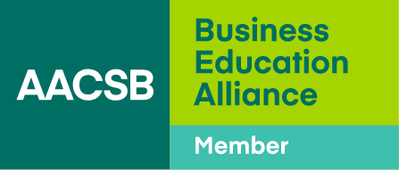

Accreditations

Slide 7
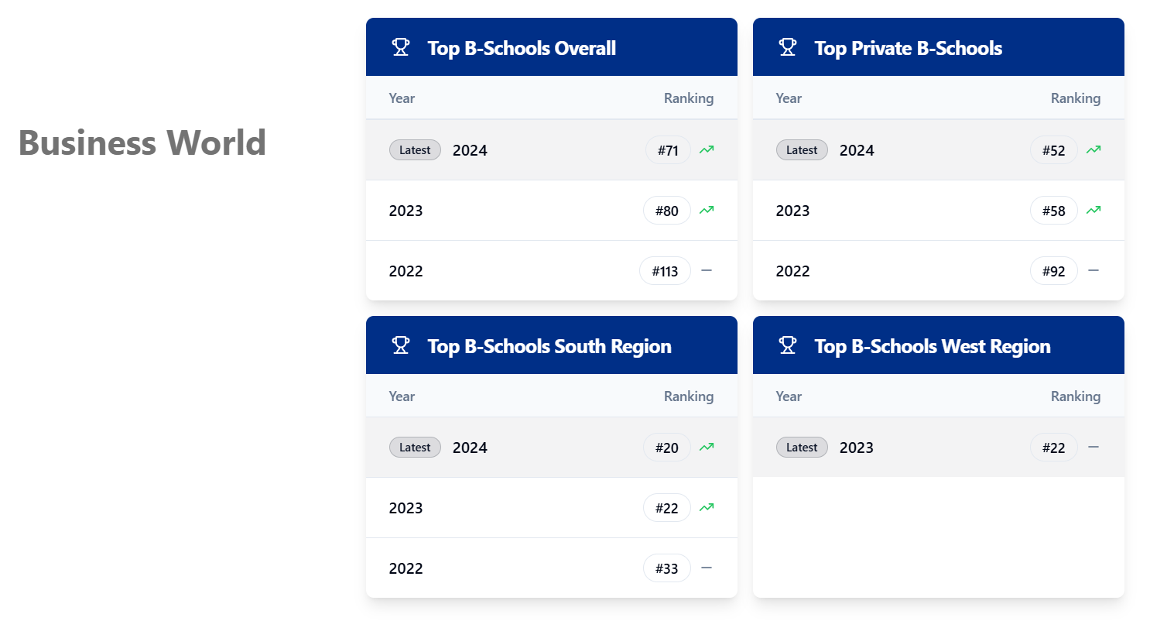
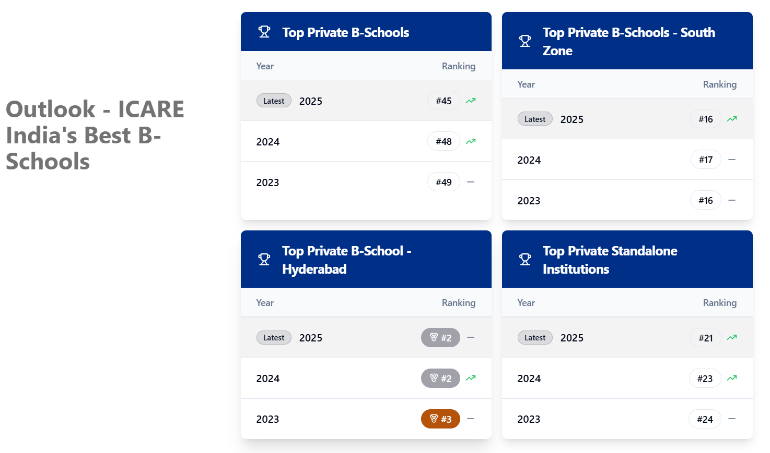
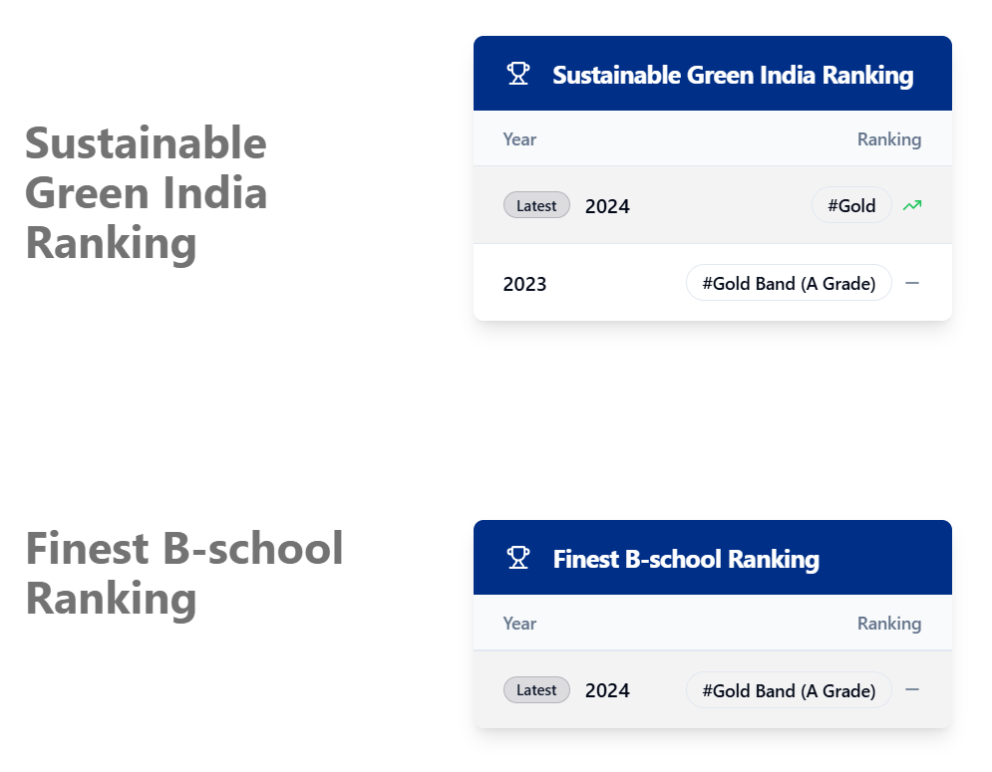
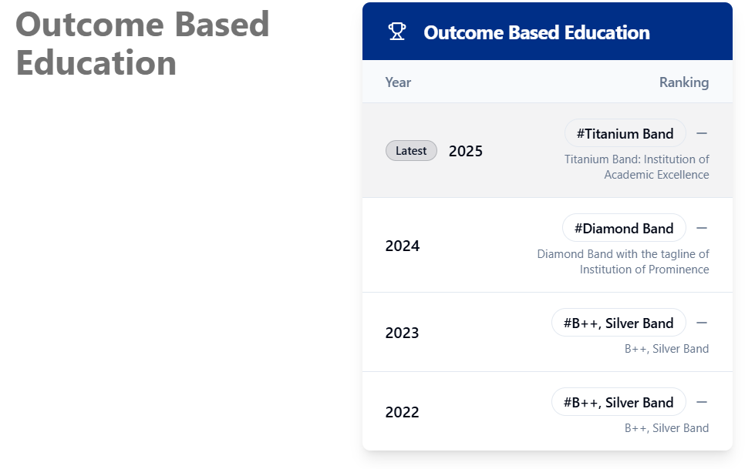
Awards

Slide 8
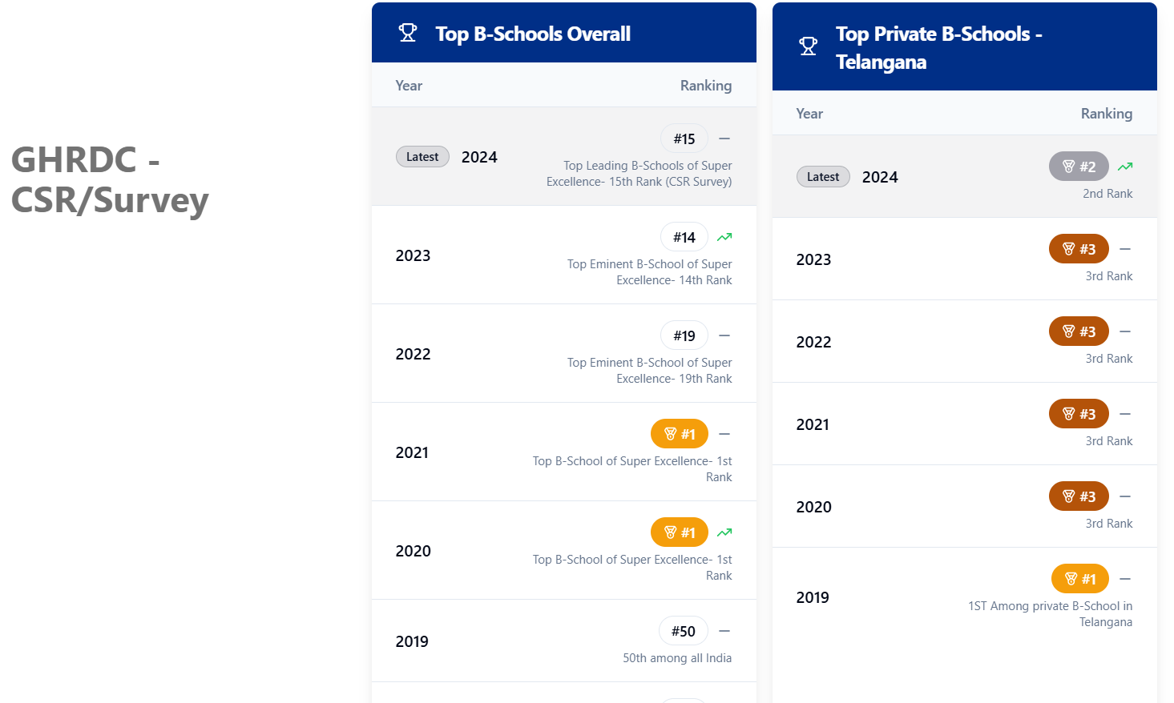
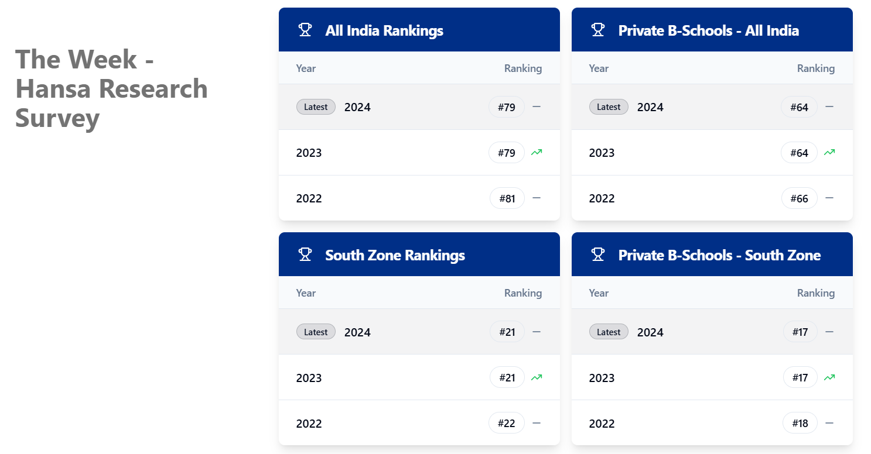
Awards

Slide 9
Programs Offered
PGDM Triple Specialization(PGDM-TPS)
PGDM Banking, Insurance, and Financial Services(PGDM-BIFS)
PGDM Business Analytics (PGDM – BA)
Fellow Program in Management (FPM)
Executive FPM

Slide 10
About PGDM TPS
Feature | Advantage | What the Students Gain
35th Batch Ongoing | Proven continuity and academic maturity | Confidence of joining a stable, time-tested institution
35 Years of Legacy | Deep-rooted credibility and trust | Strong brand value recognized by recruiters and industry
Global Immersion Program | International exposure and cross-cultural learning | Global mindset and enhanced employability
Multi-Domain Expertise | Exposure across Marketing, HR, Finance, Operations, Analytics & sectors | Ability to adapt across roles and industries
Versatility that Employers Value | Combination of domain + sectoral knowledge | Higher placement flexibility and career mobility
Future-Ready Curriculum | Curriculum aligned with analytics, fintech, digital marketing & AI trends | Graduates stay relevant in evolving job markets
Practical Learning Edge | Live projects, simulations, internships & case-based learning | Job-ready skills from day one
Robust Industry Connect | Strong corporate partnerships and industry interaction | Better internships, mentoring, and placement opportunities
Strong Placement Edge | Consistent placement performance across batches | Faster transition from classroom to corporate roles
Entrepreneurship & Leadership Development | Focus on innovation, leadership labs & entrepreneurial thinking | Capability to lead teams or start ventures
Global Alumni Network | 5000+ alumni across industries and geographies | Networking, mentoring, and long-term career support

Slide 11
About PGDM BIFS
Feature | Advantage | What the Students Gain
19th Batch Ongoing | Established program continuity and proven outcomes | Confidence of enrolling in a stable, well-evolved programme
19 Years of Legacy | Strong institutional credibility in specialized management education | Trust, recognition, and acceptance among recruiters
Versatility that Employers Value | Exposure to multiple functional and sectoral perspectives | Greater role flexibility and career mobility
Future-Ready Curriculum | Curriculum aligned with BFSI, fintech, analytics & regulatory trends | Graduates remain relevant in fast-changing financial services roles
Practical Learning Edge | Case studies, simulations, live projects & certifications | Job-ready skills with reduced learning curve
Robust Industry Connect | Direct interaction with industry experts, bodies & institutions | Better internships, mentorship, and placement access
Strong Placement Edge | Consistent placement support with sector-focused roles | Faster transition from campus to corporate careers
Global Alumni Network | Alumni presence across BFSI and allied sectors | Networking, referrals, and long-term career support
Licentiate Certification – Insurance Institute of India (III), Mumbai | Industry-recognised professional qualification embedded in the programme | Enhanced credibility for insurance and risk management roles
NISM Immersion Program @ Mumbai (3 Days) / NISM Certification | Exposure to India’s financial capital and regulatory ecosystem | Practical understanding of markets, compliance, and institutions
Certification Programs with Banking Institutions | Understanding the Software used in Banking sector and its practical operations | Competitive advantage for specialised BFSI and fintech roles
Globally Recognised ICMAI Certification (Fintech) | Internationally valued professional certification | Wider career opportunities and global recognition

Slide 12
About PGDM BA
Feature | Advantage | What the Students Gain
5th Batch ongoing | Young yet proven program with evolving best practices | Confidence of learning from a refined, contemporary curriculum
5 Years of Legacy | Rapidly built credibility in analytics education | Trust and recognition among recruiters and industry partners
Business Analytics + One Major Specialisation | Integration of analytics with functional domain expertise | Ability to apply data skills directly to business roles
Versatility that Employers Value | Blend of analytics, domain knowledge & problem-solving skills | Higher employability across industries and functions
Future-Ready Curriculum | Coverage of data analytics, AI tools, business intelligence & emerging trends | Graduates remain relevant in data-driven job markets
Practical Learning Edge | Hands-on projects, labs, case studies & tool-based learning | Job-ready analytical skills with real-world exposure
Robust Industry Connect | Strong engagement with analytics professionals and organisations | Better internships, mentoring and placement opportunities
Strong Placement Edge | Consistent placement support for analytics and domain roles | Faster entry into analytics-driven career paths
Global Alumni Network | Growing alumni base across analytics and business domains | Networking, career guidance and long-term professional support
In Collaboration with IBM | Learning aligned with global technology and analytics standards | Enhanced credibility and exposure to industry-grade tools
Industry Certification Courses | Embedded certifications aligned with analytics roles | Competitive advantage in hiring and career progression
Membership – Analytical Society of India | Access to professional training, workshops & industry events | Continuous skill development and professional networking
Course Accreditation – Association of Analytics | External validation of curriculum and learning outcomes | Increased programme credibility and industry acceptance
Business Analytics Lab | Dedicated infrastructure for hands-on analytics practice | Practical mastery of tools, datasets and analytical models

Slide 13
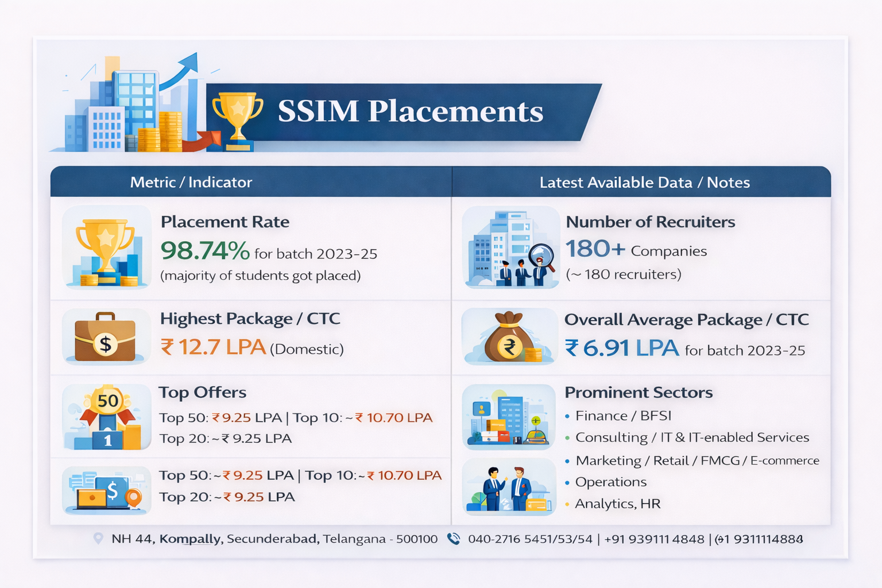

Slide 14
